Slide 1

Why Are you Podcasting?
Doing
Podcasting the Right Way

Slide 2
Requirements
Host/Angle
Who are you Reaching?
Track Your Progress

Slide 3

The six pack

Slide 4
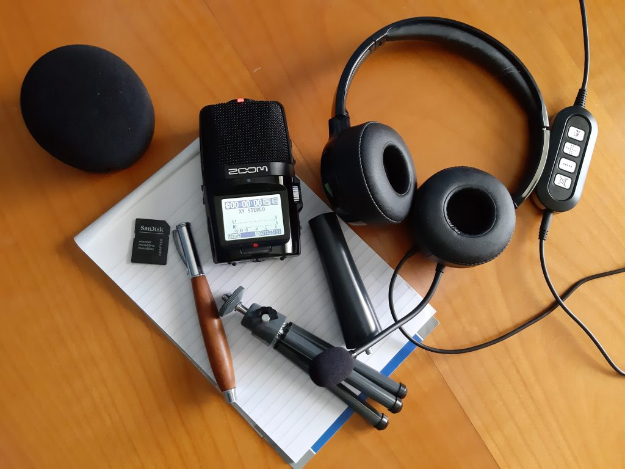

Key to Success
Compelling
Content
Consistency
Quality
Production
Engage
Your
Audience
Effective
Marketing & Promotion

Slide 5
Watch Your insights

Slide 6


Thank You
Email
amkay@ewtn.com

