Slide 1

Mastering the Art of Radio Hosting
EWTN RADIO

Slide 2

Mastering the Art of Radio Hosting
Rule #1: Talk as if you are talking to 1 person
Rule #2: Content is King!
Rule #3: Spotlighting the listeners
Rule #4: Make Appointments
Rule #5: Watch your tone!
Rule #6: Reveal Yourself
Rule #7: Have Fun
You may be the ONLY Jesus someone sees today!

Slide 3

Show Prep
PREP IS LIFE!

Slide 4

SHOW PREP CHECKLIST:
+News -Economy, Entertainment, Relationships (kids & pets included) +Social Media +Grocery store conversations +Dinner Table +The Liturgy Calendar +Things that birth out of the show.
Simple Prep Checklist: Transparent
Brand | Trends | Agenda | Superstar

Slide 5

What is your camera angle?
What is most compelling view of what’s happening in the scene?

Slide 6

Understand the Emotions of the Topics
Understand the Emotions of the Topics Be the Moon, Not the Sun!
Once you realize this, show prep gets SO much easier.

Slide 7
Why is it on?
Your Role as you tell it
What matters most to your listener TODAY?
Where are you going with it?

Slide 8

Crutches, Throwaways & Bad Habits
Things like “for your Thursday”, “welcome to Monday”
Don’t repeat yourself
Allow yourself to hear your habits so you can stop them from getting in the way.

Slide 9
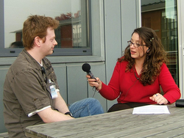
Interviews
Not everything needs to be included in the audio and not everything in the audio needs to be included
What’s the one thing you wish you knew when you were at your lowest? Tell me THAT!

Slide 10

EGG Reps
Pick the 2 things that effect your show and work on that
Motto: If less is MORE than more is TOO MUCH!

Slide 11
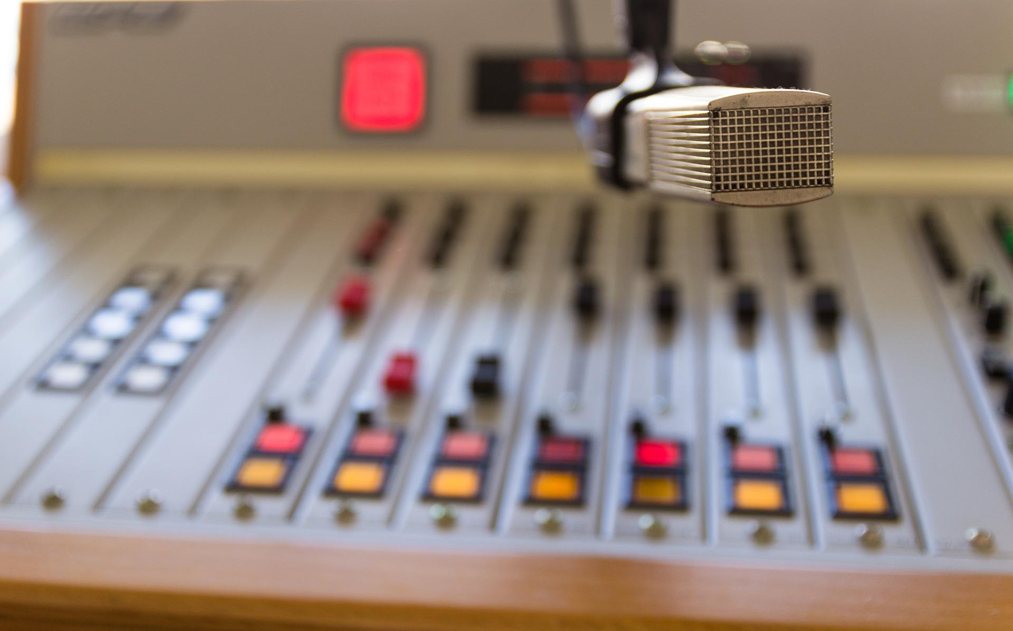
ATTN: Producers!
-Bells & Whistles matter
-Imaging Enhances
-Listen to your producer!

Slide 12

EMAIL: AMCKAY@EWTN.COM

