Slide 1
Morning Show
Prep
Maximize hosting the local 9 minute segments

Slide 2
LOCAL:
What is the brand of the station and the brand of the day that needs top priority.
Focus on Saint Day, Feast Day, crazy weather days, upcoming holidays, seasons, etc.
Meet your audience where they are (Literally, Spiritually, Emotionally)
Notes:
Create an outline to get ready:
Introduce the era (Use a mix of media and text)
Organize your artifacts to outline what life was like during the era you are presenting
Think about using a storyboard to outline your images and ideas
Make sure you prepare a clear and well rounded presentation of all aspects of the era (People, jobs, food, transportation, etc. What else should you include so the audience feels like they have visited your era?)

Slide 3



Reveal Yourself
Who you are!
Station & Show Brand
Connect to YOU the host
Transparency

Slide 4
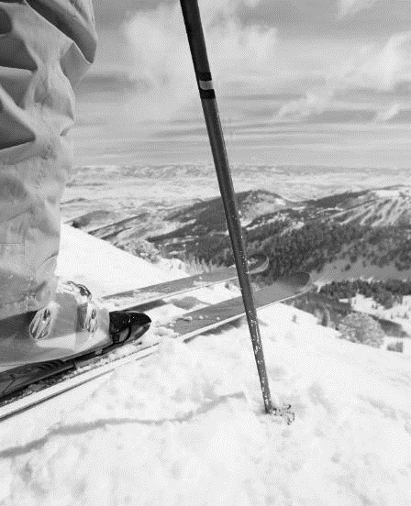
Sparks & Springboards
Social Media
Liturgical Calendar
Station/Local Events
Your Own Lives
  -What does the audience care about?
  What are you saying that adds value?
Trends
Friends
Community
Trust
Faith

Slide 5

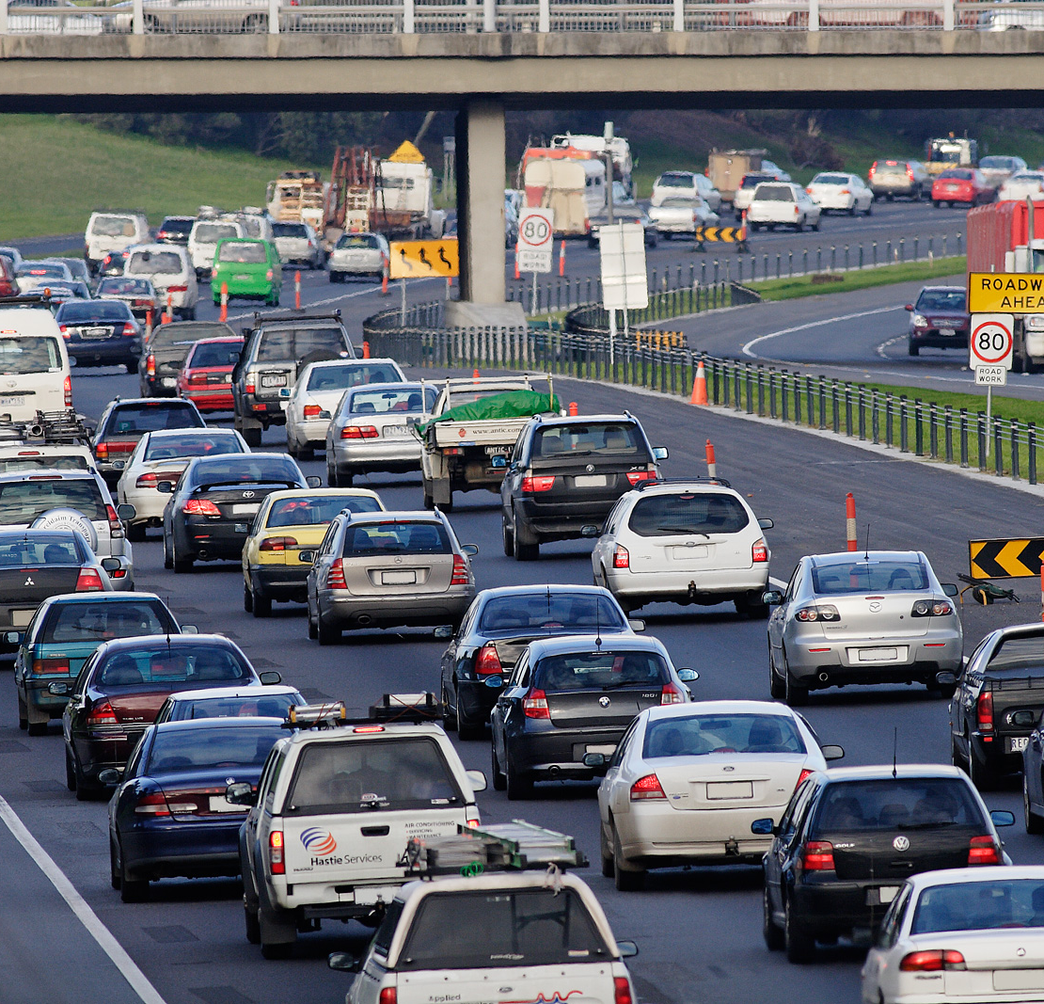
Weather
&Traffic
Tie the day together with how they start their day
Simple forecast with a few local temps & any big spots on the roads.

Slide 6
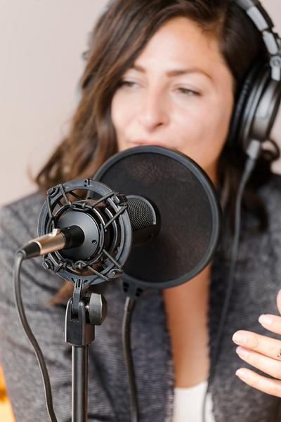
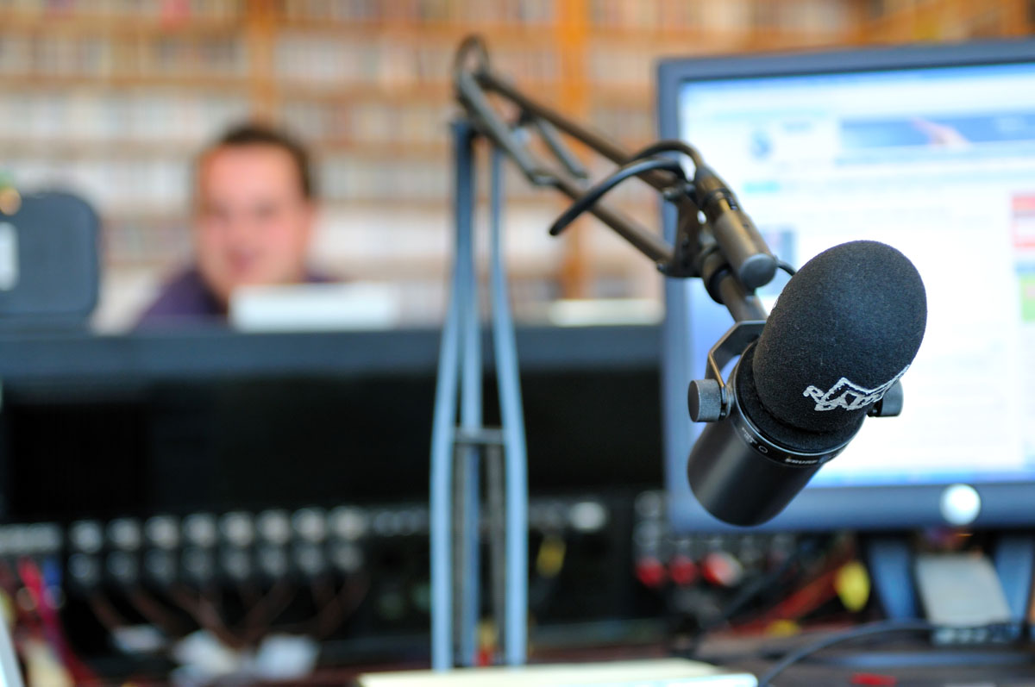
Guests
Welcome
1 or 2 per morning
Topic or event related
Shows you working together with local churches and organizations

Slide 7
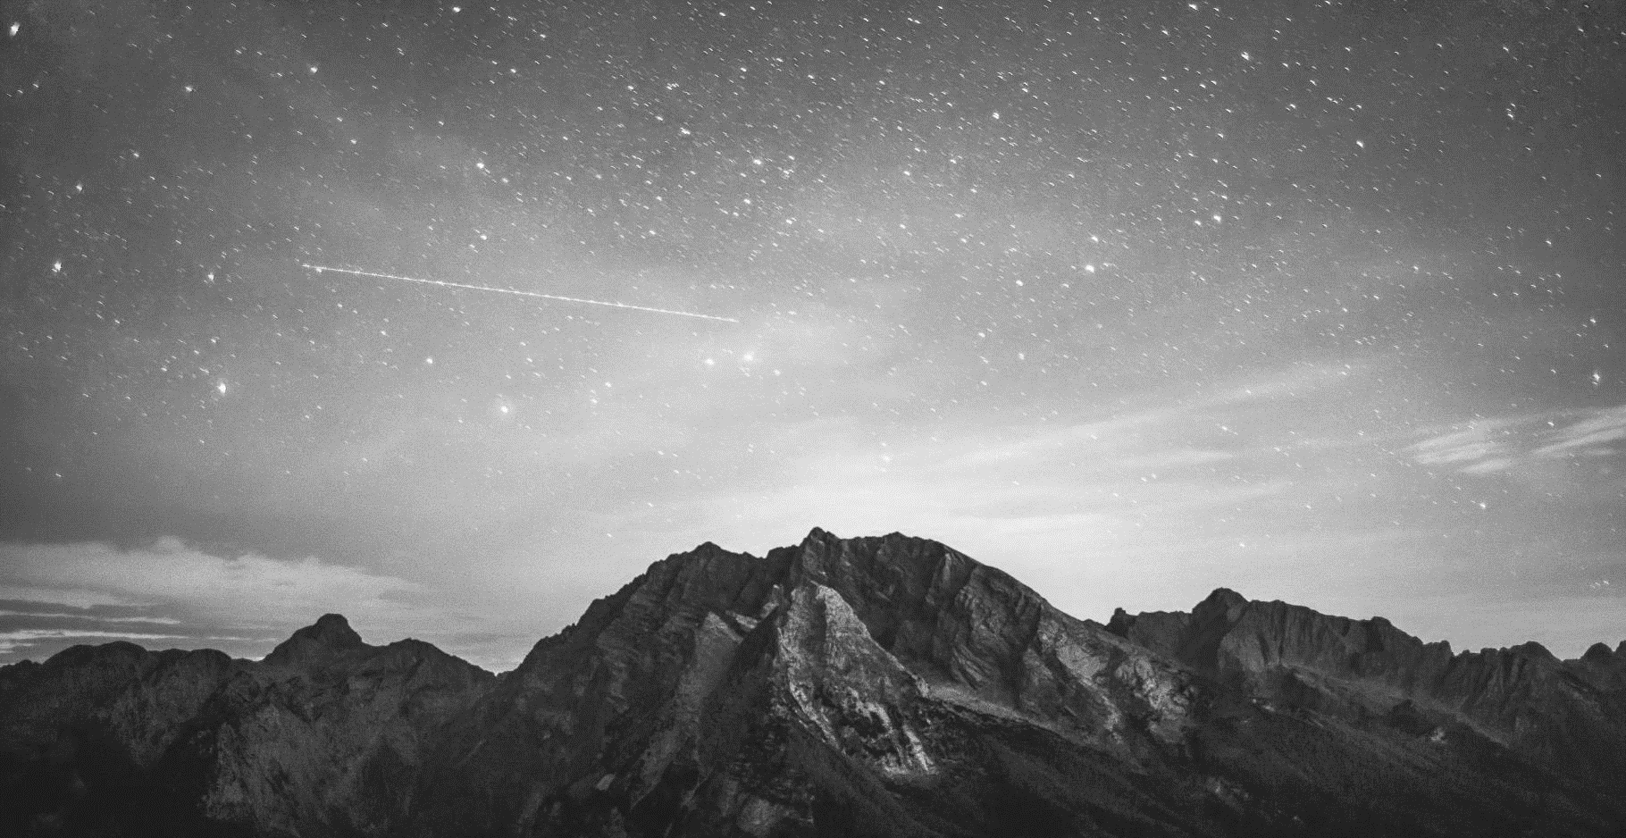

NOT everything you ask needs to go on the air and not everything that goes on the air needs to be asked.

Slide 8
Great Interviews
What are we learning?
Why should I care?
What are they learning that they won’t get elsewhere?
Make it personal to the audience and your stations
They may already care but if they don’t you are heightening their attention to something that requires their attention so make it count.

Slide 9

What did they learn about you?
Reset your segments:
Remind them who you, why you are talking to your guest and who they are

Slide 10
Remember you may be the only Jesus people see or hear all day
Be a light |Be real |Be Welcoming

Slide 11
What did your audience learn from you today?

Slide 12

Show Prep Clock
Open/Greetings 60-90 seconds
Weather/Traffic 30 seconds
Local Trends/Interview 1 3-5 Minutes
Segment Reset 30 Seconds
Local Trends/Interview 2 3-5 Minutes
Wrap up 60 Seconds
(Times will vary based on the depth of the interviews)

Slide 13

Email: amckay@ewtn.com

