Slide 1

EWTN AFFILIATE
Promotions

Slide 2

How to Use This!
Quarterly
planning
Creative insight
teamwork

Slide 3

How to Use This!
Expectation
Realization
Memory
Side note: experiences are more memorable than a prize.
Experiences change lives.

Slide 4
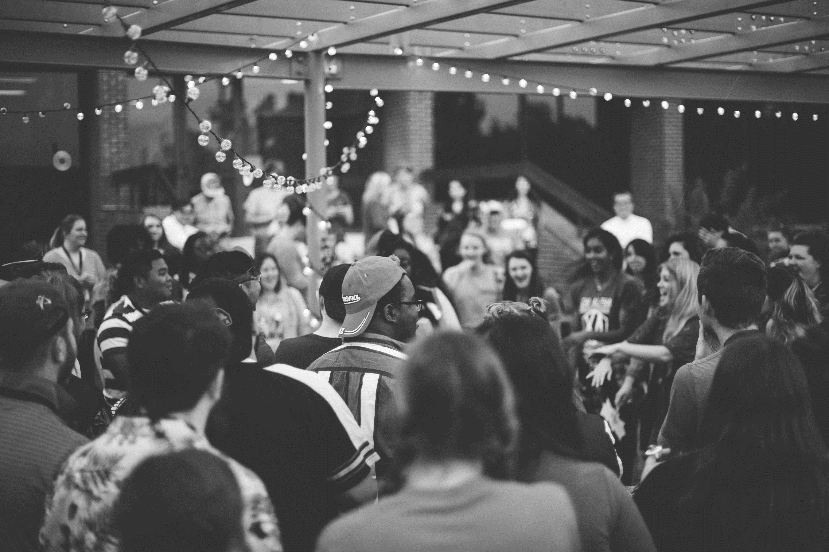
Promotions Checklist
At Events its about Signage
Station
Awareness
Where & How
Community Involvement Helps You Stand out

Slide 5



In partnership with local restaurants: Pick a local office to win free lunch or donuts & coffee Benefit: Allows you be in front of businesses and heighten awareness of your station How it works: Sign up at the web site and draw your winner once a week.

Slide 6


In partnership with good causes: Build our community Benefit: You would be a partner for an event that’s already happening in the community that you can put your name on and own it as your own. How it works: Sign up people at the web site for donation or registration and then the day of the event send staff/street team to the event and greet people as they come to participate.

Slide 7

In partnership with local organizations or churches: Helping families at Christmas How it works: Post on your web site with suggested items for the stockings List of Dropoff Locations

Slide 8

In partnership with local organizations or churches that are helping families at Christmas How it works: Post on your web site where people can drop them off. Other Items you could collect: Baby Stuff, Coats, School Supplies, etc.

Slide 9

In partnership with local sports teams, you promote their already existing Faith Nights for church groups to get together. How it works: Post the date of the game on your web site with a link for people to get tickets in advance at a discount rate. At the event: -Set up table -Hand out swag -Throw out 1st pitch (take a listener with you) -Have a host pray before the game on the jumbotron

Slide 10

In partnership with local organizations or churches: You award a local family with items they need during a difficult time How it works: Sign up/Nominate at the web site and draw your winner once a month.

Slide 11

In partnership with local schools, you select a teacher of the month based on student or parent entries to your website. How it works: Sign up/Nominate at the web site and draw your winner once a month. Arrange to have a staff/street team member deliver the trophy or certificate to the winner’s school with station swag that help spread the word about the station.

Slide 12

NOW WHAT?
Pick
Build
Spark

Slide 13

Email: amckay@ewtn.com
“Find a need & fill it;
Find a parade & get in front of it!”

