Slide 1


EWTN
Radio Conference
Mission Advancement
November 2018

Slide 2
Scott F. Brown
Vice President, Mission Advancement
EWTN
Notes:
Joined EWTN in June
Worked for a congregation of priests in executive and fundraising roles for 14 years
Worked in the defense industry in the DC area for 20 years prior to that
Grateful to be a part of such a wonderful organization

Slide 3
What we’ll cover today
  EWTN Mission Advancement Overview
  Points to Ponder
    Point 1: Start With Why
    Point 2: Who is your fundraiser?
    Point 3: Brand and Message
    Point 4: God’s Providence
    Point 5: Simplified Gift Cycle
    Point 6: Simplified Integrated Fundraising
    Point 7: Tools
    Point 8: The Magic Fundraising Silver Bullet
  Q&A

Slide 4
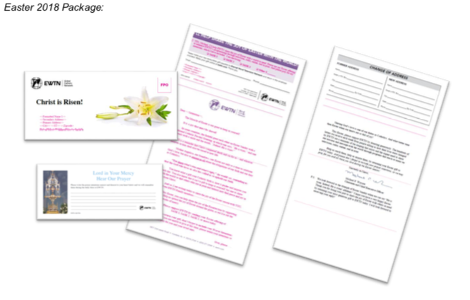
Mission Advancement Programs
Direct Mail
  Appeals
    Mailed monthly to 150,000 current active donors
  Newsletters
    Mailed monthly to 200,000 current active donors
  New Donor Acquisitions
    Mailed Semi-annually to 400,000 homes from purchased lists
Notes:
Appeal: Responses 5000-10000 month
Newsletters: Responses 10000-16000 month
Acquisition: 1000-3000 per mailling
Accounts for about 50% of our fundraising revenue

Slide 5

Mission Advancement Programs
On Air Appeals
  Video Spot airing 8-12 times per day
  January - November: Impact Testimonial
  December: Thank You and Year End Accomplishments featuring Michael Warsaw and Fr. Joseph
Notes:
Accounts for about 15%

Slide 6

Mission Advancement Programs
Online
Weekly Email Appeal
  Sent to ~125,000 subscribers of Wings e-newsletter
  Follows messaging of OnAir Spots
Donate buttons on website, social media posts and newsletters
NextAfter Digital Initiative launched in July
Notes:
Accounts for about 20% of revenue

Slide 7

Mission Advancement Programs
Major Gifts
Mission Advancement Officers actively working portfolios of 125-150 current donors and prospecting
Region | MAO
Northeast | Final Interview
Midwest | David Amirault
Southeast | Maria Vickroy-Peralta
Western | Cathleen Collins
South Central | Late FY2019 or FY2020
Notes:
Accounts for about 15% of our revenue

Slide 8
Messages from EWTN Viewers/Listeners
  A refuge for those of us who spend a lot of time in our cars
  An oasis from the noise of our culture
  Thank you for the great work that you do every day

Slide 9
Point 1: Start with Why
  “People don’t buy what you do,
  they buy why you do it”
  Simon Sinek, 2009
  Ted Talk: How Great Leaders Inspire Action

Slide 10
Start with Why
What
How
Why
Notes:
Most companies start with what they do.
Successful companies start with why they do it

Slide 11
Two Fundraising Examples
  Pitch 1
  What: We need your help
  How: Please give us money now
  Why: We’ll have to shut down if you don’t
  Pitch 2
  Why: We change lives
  How: We transmit the Truth of the Eternal Word
  What: We are the Catholic Radio Station in your hometown. Please join us in changing lives.
Notes:
Let’s translate that to fundraising

Slide 12
Why do you fundraise?
  Because a young woman is considering an abortion
  Because a young priest needs your message so he can persevere in his vocation
  Because a grandmother is lonely
  Because if you don’t, no one will
  Because Jesus Christ proclaimed to all of us “Go therefore and make disciples of all nations”

Slide 13
Start With Why
People don’t buy what you do, they buy why you do it
What
How
Why

Slide 14
Point 2: Who is the fundraiser in your organization?
EVERYONE!
Notes:
Everyone has connections
Everyone can contribute the fundraising effort in some way

Slide 15
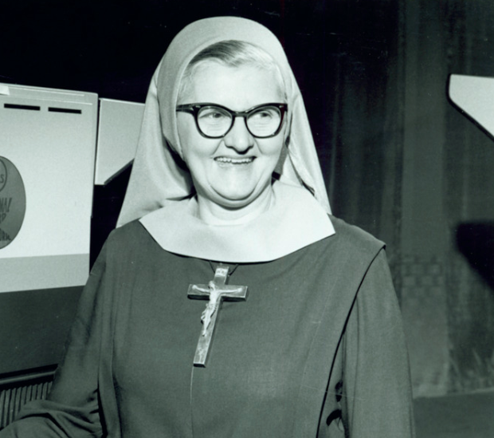
Point 3: Brand and Fundraising Message
“And Remember, Keep Us Between Your Gas and Electric Bill…..”
Mother M. Angelica
Notes:
37 years ago, Mother Angelica started this simple message, 15 Years after she was last on the air, people still keep EWTN between the gas and electric bill
Great lesson to be learned, I can’t emphasize enough the importance of building your brand and being consistent with your message
School gala example

Slide 16
Point 4: God’s Providence
“Unless you’re willing to do the ridiculous, God will not do the miraculous”
  Mother M. Angelica
Be prepared: Pray and Use your gifts and talents
John 6:1-14
  Feeding of the 5,000
  John 6:9
    The boy who was prepared
      “There is a lad here who has five barley loaves and two fish”
Notes:
Prepared: Does trusting in God’s providence mean waiting for him to do all the work?
Mother prepared. She made connections. She communicated her Why
Feeding of the 5000 is in all four gospels
Only John talks about the little boy
We have to do the work to be prepared. The boy is the only one who was prepared. He brought lunch
What do I mean: God will do the miracles if we are faithful and we use the gifts he has given each of us to prepare the way

Slide 17
Point 5: Simplified Gift Cycle
Ask
Donation made, donors feels good…
But uneasy, they don’t know what you will do
Trust grows
Donor feels they made a difference…
Donor feels appreciated…
Report
Thank You
But did the gift make a difference?
Notes:
Being prepared for receiving, appreciating and stewarding your donors
Feels good, but not sure what you are going to do
Appreciated, but doesn’t know if it makes a difference
Impact is understood and trust grows, opportunity for repeat gift

Slide 18
Point 6: Simple Integrated Fundraising
On Air Appeal: Communicate “Why”: Impact Testimony
Email/Social Media Appeal 1: Supports on-air appeal to cultivate donors
Letters or Direct Mail: Presents high level case for support, reinforces “why”, with solicitation
Email Appeal 2: “Chases" your letter or direct mail with case for support, “why” reinforcement and solicitation
Major Gift Asks: In-depth case for support presentation with impact stories that flow from your “why”, highly individualized gift proposal for select donors
Notes:
Which leads me to Point 5
Preparing the way in fundraising
On Air: Testimony
Email Appeal 1: Testimony in digital form
Letters/Direct Mail: Case for support with testimony from OnAir
Email Appeal 2: Chase your letter and direct mail
Major Gift Ask: Meet face-to-face with highest prospect donors

Slide 19
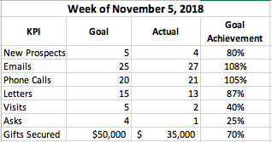
Point 7: Tools
Accountability: Weekly Activity Reports or Scorecards
Tracking: Donor Pipeline
  Database Software
  Excel
  Index cards in a shoebox
Notes:
Be Accountable, Ask someone to be your accountability partner
Whatever type of pipeline allows you to segment donors by type and to keep track of where they are in the gift cycle

Slide 20
Point 8: The Magic Fundraising Silver Bullet
There is no magic, fundraising silver bullet
Notes:
It’s hard work
There are no gimmicks
It requires an integrated plan
It requires faithful execution of the plan day in and day out, every day
It takes patience and persistence
It requires being prepared
And it requires you to commit to fundraising every day
Follow the previous 7 points that I presented today

Slide 21
Keep it Simple: Follow the Steps
  Start With Why
  Everyone Fundraises
  Consistent brand and fundraising message
  Trust in God’s Providence and be prepared
  Follow the Gift Cycle
  Integrated your fundraising channels
  Use tools that help you manage fundraising

Slide 22
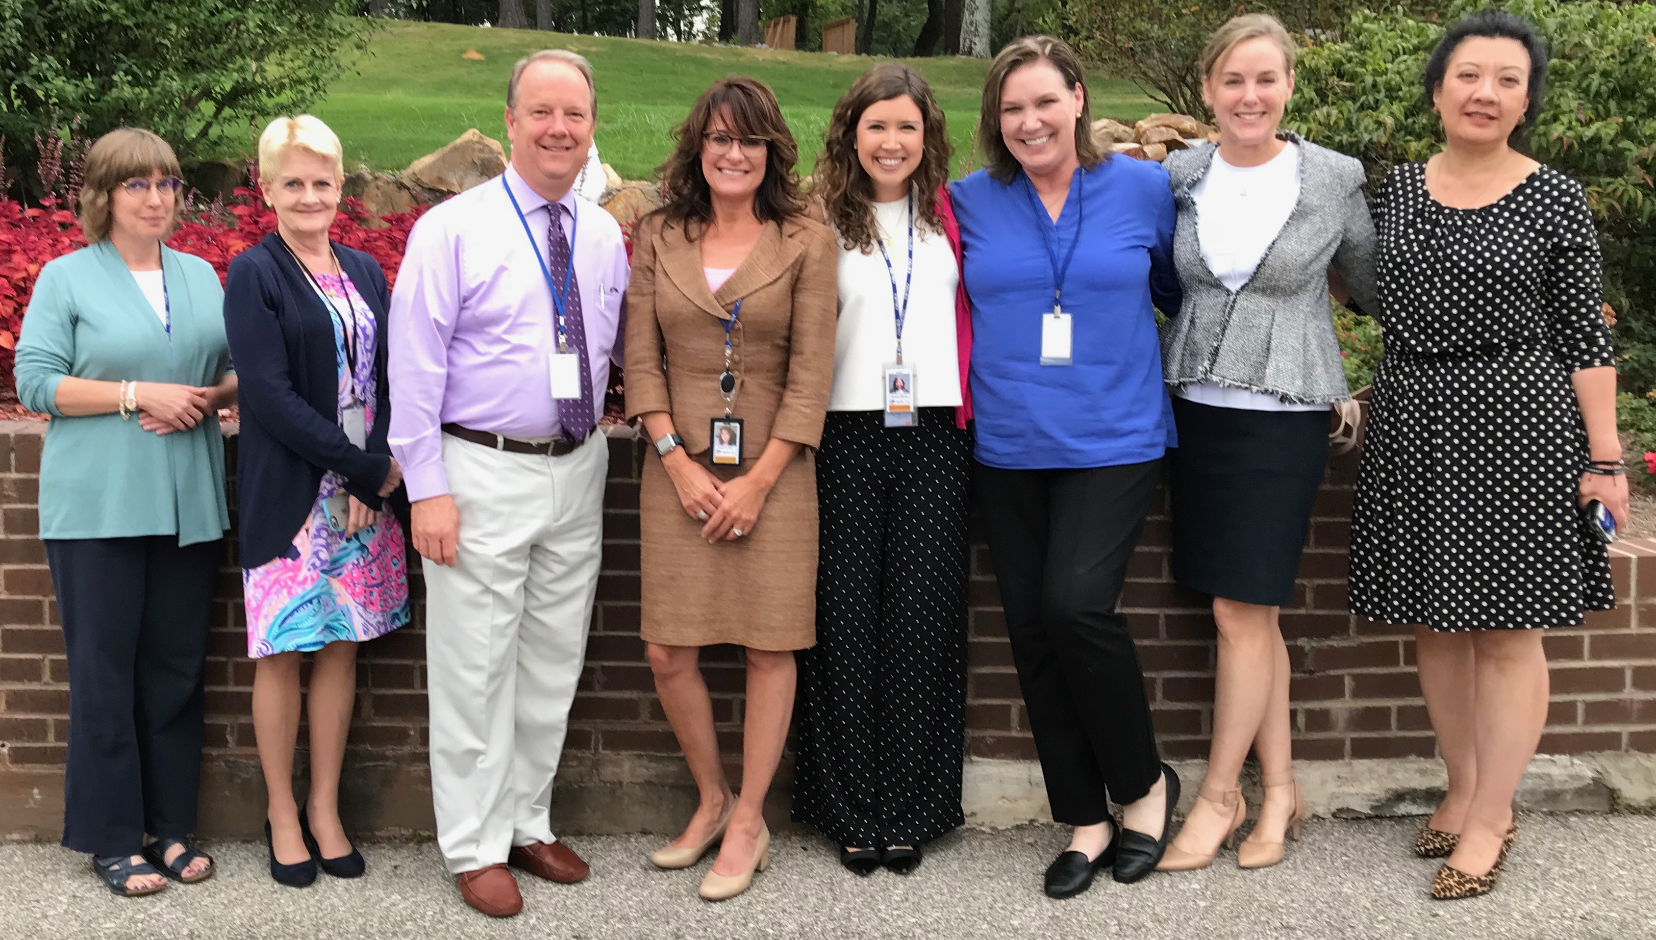
EWTN Mission Advancement Team
Ready to Help You
Mission Advancement Officers
  Maria Vickroy-Peralta: Southeast Region - January 2018
  Cathleen Collins: Western Region - October 2017
  David Amirault: Midwest Region - November 2018
  Interviewing for Northeast Region
Legacy Giving
  Ryan Flood: Legacy Giving Advisor - September 2018
Direct Response Program
  Rebecca Kessler: Direct Mail Manager - March 2018
  Elizabeth Maziarz: Seasonal Acquisition Mail Processing - August 2018
Advancement Services
  Leslie Rabbitt: Advancement Services Manager - September 2016
  Teresa Pitts: Donor Direct Application Analyst - February 2018
  Ashley Martin: Advancement Services Coordinator - April 2018
Admin
  Regina Gumina: Administrative Assistant - August 2018

Slide 23
My Contact Info
Scott F. Brown
sfbrown@ewtn.com
443.812.5884
205.278.8470
Notes:
It’s hard work
There are no gimmicks
It requires an integrated plan
It requires faithful execution of the plan day in and day out, every day
It takes patience and persistence
It requires being prepared
And it requires you to commit to fundraising every day

Slide 24
Questions and Answers
Notes:
It’s hard work
There are no gimmicks
It requires an integrated plan
It requires faithful execution of the plan day in and day out, every day
It takes patience and persistence
It requires being prepared
And it requires you to commit to fundraising every day

Slide 25
EWTN Radio Conference
Mission Advancement
November 2018

Slide 26
Systems Status: Stabilize (Donor Direct/Leslie Rabbitt/IS)
DD Major Gift User Functionality
List Management for Fundraising
DD Enterprise Deployment (Exchange/GP/Viewer Services)
DD Digital Fundraising (Ease Use/Flexibility/Deployment/Measures)

